Slide 1
Persistence with JPA
Module: APPE

Slide 2
Agenda
Data Modeling with UML
Implementation as Relational Schema
Refresher: JPA / ORM Basics
Creating the Persistence Layer
CRUD Operations
JPQL
Pitfalls and Best Practices

Slide 3


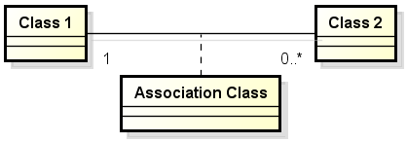
Data Modeling with UML
The goal of data modeling is to define the data requirements needed for the business cases in the system. We use an UML class diagram to model the data structure of the system.
Elements:
Class | defines the structural attributes
Association | defines the relationship between classes
Association Class | defines association with attributes

Slide 4
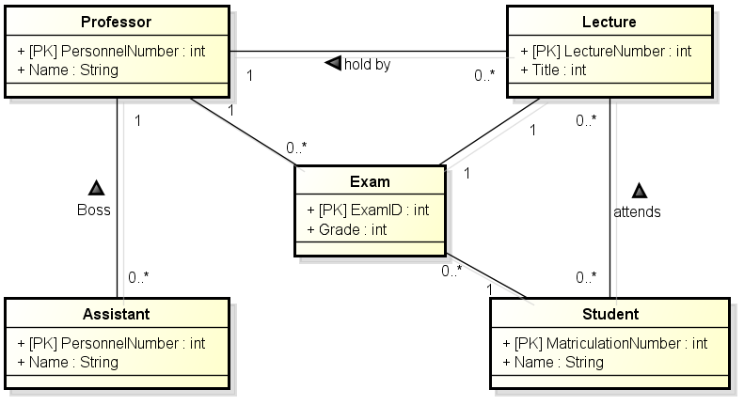
Data Modeling with UML
Logical Data Model
There are many UML editors available:
Editor:
http://astah.net/editions/community
List of Unified Modeling Language tools: http://en.wikipedia.org/wiki/List_of_Unified_Modeling_Language_tools

Slide 5
Levels of Entity–relationship modeling
Conceptual Data Model:
Overall Scope, Master Data Entities
Logical Data Model
Master Data Entities + Operational + Transactional Data Entities
Independent of technology. Domain Model
Physical Data Model
Fully modelled with all details to produce the database. Dependent of technology. Tables, Indexes, Keys, Constraints.
Notes:
Master Data Entities: Key Business Entities
Transactional Data Entities: Business Events

Slide 6
Conceptual Data Model | Logical Data Model | Physical Data Model
Overall Scope |  | Fully modelled with all details to produce the database
 | Independent of technology | Dependent of technology
Master Data Entities + Operational + Transactional Data Entities | Master Data Entities + Operational + Transactional Data Entities
Notes:
cd c:\Users\tcchrist\workspace\edu\appe\input

Slide 7
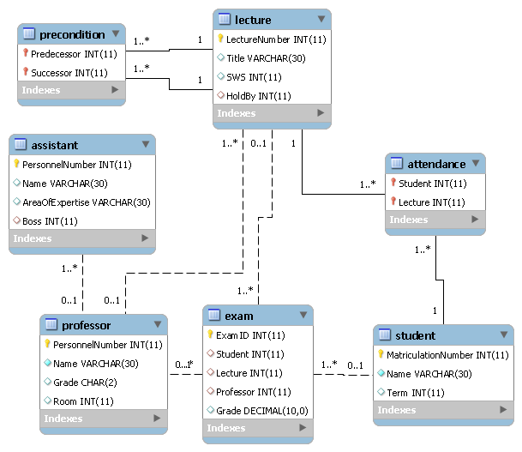
Implementation as Relational Schema
The relational Schema is a common way to implement a logical data model. We can use SQL DDL or the user interface of a DBMS to create the schema.
Creating a physical data model for a database:
define all details to produce database
map m:n relationships to associative tables
define PK, FK and indexes
….
Notes:
- FK: important for data integrety
- FK: important for Database First Approach
- PK: use auto increment where possible

Slide 8
Implementation as Relational Schema
Tips:
Associative tables with attributes: add autonumber field and create artificial primary key (Surrogate Key)
Pure associative tables without any attributes: use FKs as primary key (Compound Key) -> no extra relationship class needed

Slide 9
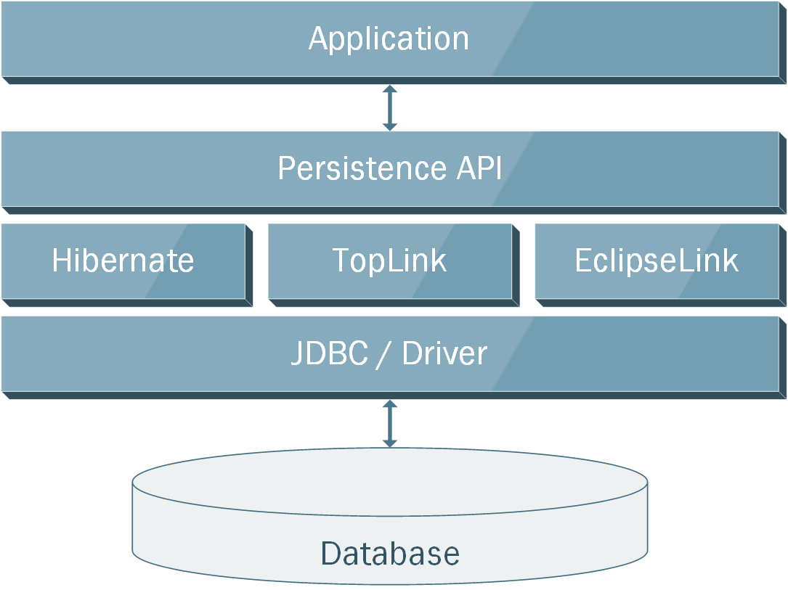
Refresher: JPA / ORM Basics
Notes:
ORMs: EclipseLink (RefImplementation), Hibernate, TopLink, Oracle,…..

Slide 10
Refresher: JPA / ORM Basics
JPA Elements:
Entity: Java class, mapped to a table in the database
Annotation: Definition of the OR mapping (Java class to database table)
EntityManager: Class to access entity objects and perform persistence operations
Persistence Unit: Configuration data for connectivity, DB driver, …
JPQL: Object-oriented query language, platform-independent

Slide 11
Refresher: JPA / ORM Basics
JPA Annotation:
@Entity: Designate a java class as entity
@Table: Specify the table associated with the Entity (optional)
@Id: Designate a field as primary key
@Column: Associate a field with a column (optional)
@OneToMany: Define association with one-to-many multiplicity
@ManyToMany: Define association with many-to-many multiplicity
…
Notes:
http://www.javabeat.net/eclipselink-jpa-annotations/

Slide 12
Creating the Persistence Layer
There are two approaches to create the persistence artifacts:
Code First:
Create all entity classes in Java, add the annotations to map the classes to tables and let the ORM create the database.
Database First: Create all tables in the database and use an IDE to generate all entity classes and the required annotations.
My Approach:
Initial Project Setup: Database First. Less to write + SQL easier to verify than JPA
Development with local Database: Code First with strategy Drop and Create. Schema is implicitly under version control via entity classes.
Development / Integration with shared or productive Database: no auto generation, in order to detect compatibility issues.
Notes:
Explain strategy and where ot set

Slide 13
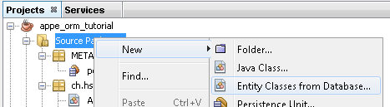
Creating the Persistence Layer
with Netbeans
Create the database schema (with SQL or DBMS Editor)
use Netbeans / Services or an external Tool such as MySql Workbench.
In Netbeans add the library EclipseLink (or the ORM of your choice) to the project as well as the MySQL JDBC Driver.
In Netbeans choose new and Entity Classes from Database and follow the steps in the wizard.
Notes:
- use local mysql first
- deselect all options, except use col names in relashion ship

Slide 14
CRUD Operations with referenced Entities
Create:
// prepare
EntityManagerFactory emf = Persistence.createEntityManagerFactory(Config.DB_Link);
EntityManager em = emf.createEntityManager();
// Retrieve required Data
Professor p = em.find(Professor.class, NamedRecords.ProfSokrates);
// create Record
Assistant me = new Assistant();
me.setName("Roli Christen");
me.setAreaOfExpertise("SW Development");
me.setBoss(p);
// insert
em.getTransaction().begin();
em.persist(me);
em.getTransaction().commit();
Notes:
- show database content and illustrate effectz of persist (memory only) and commit (db synched)

Slide 15
CRUD Operations with referenced Entities
Read:
// retrieve Entity and related Entities
Professor p = em.find(Professor.class, NamedRecords.ProfSokrates);
for (Lecture l : p.getLectureCollection()) {
System.out.println(
String.format("Professor %s holds lecture %s",
p.getName(), l.getTitle())
);
}
Referenced Entities are automatically loaded (fetching strategies: EAGER or LAZY)

Slide 16
CRUD Operations with referenced Entities
Update:
// update multiple Entities
Professor p = em.find(Professor.class, NamedRecords.ProfSokrates); em.getTransaction().begin();
p.setName(p.getName() + " 2.0");
for (Assistant a : p.getAssistantCollection()) {
a.setName(a.getName() + " 2.0");
}
em.getTransaction().commit();
Modifications to entities are stored in the database when the transaction is committed or the method flush is invoked.
Modifications to entities are only stored in the database when the entities are managed (managed and detached entities, see Pitfalls and Best Practices)

Slide 17
CRUD Operations with referenced Entities
Delete:
// remove Entity
Lecture l = em.find(Lecture.class, LectureMaeeutik); em.getTransaction().begin();
em.remove(l);
em.getTransaction().commit();
Caution: already loaded collections, containing the now deleted entity, are not automatically updated (2nd Level Cache Problem).
See Pitfalls and Best Practices

Slide 18
JPQL
Object-Oriented Queries
Select (typed):
// query all Professors with Grade C4
TypedQuery<Professor> query = em.createQuery("SELECT p FROM Professor p WHERE p.grade = 'C4'", Professor.class);
List<Professor> results = query.getResultList();
Select (mixed)
// query all Professors with Assistants
Query query = em.createQuery("SELECT a.boss, COUNT(a) AS C FROM Assistant a GROUP BY a.boss HAVING COUNT(a) > 0");
List<Object[]> results = query.getResultList();
// show Results
for (Object[] record : results) {
Professor p = (Professor) record[0];
long employees = (long) record[1];
…
}
Notes:
- show intellisense feature for JPQL String

Slide 19
JPQL
Object-Oriented Queries
Select (with JOIN):
// query all Professors with Assistants
TypedQuery<Student> query = em.createQuery("SELECT DISTINCT s FROM Student s JOIN s.lectureCollection l WHERE l.holdBy.grade = :grade", Student.class);
query.setParameter("grade", "C4"); List<Student> results = query.getResultList();
Update
// set Grades 2 to Grades 1
em.getTransaction().begin();
Query query = em.createQuery("UPDATE Exam e SET e.grade = 1 WHERE e.grade = 2");
int rowCount = query.executeUpdate();
em.getTransaction().commit();

Slide 20
JPQL
Object-Oriented Queries
Delete
// remove all lectures from Prof. Popper
em.getTransaction().begin();
Query query = em.createQuery("DELETE FROM Lecture l WHERE l.holdBy.personnelNumber = :prof");
query.setParameter("prof", NamedRecords.ProfPopper);
int rowCount = query.executeUpdate();
em.getTransaction().commit();

Slide 21
Pitfalls and Best Practices
Managed and detached Entities
Persist vs Merge
Persist: takes an entity instance, adds it to the context and makes that instance managed (future updates to the entity will be tracked).
Merge: creates a new instance of an entity, copies the state from the supplied entity, and makes the new copy managed. The instance passed in will not be managed (any changes made to the entity will not be part of the transaction - unless merge is invoked again).

Slide 22
Pitfalls and Best Practices
Managed and detached Entities
Scenario A:
t.begin();
p = new Professor();
p.setName("Professor A1");
em.persist(p);
p.setName("Professor A2");
t.commit();
Professor is stored in the database with name "Professor A2"
Scenario B:
t.begin();
p = new Professor();
p.setName("Professor B1");
em.merge(p);
p.setName("Professor B2");
t.commit();
Professor is stored in the database with name "Professor B1"
Changes made after merging are not synchronized
Passed entity p is not managed

Slide 23
Pitfalls and Best Practices
Managed and detached Entities
Scenario C:
t.begin();
p1 = new Professor();
p1.setName("Professor C1");
Professor p2 = em.merge(p1);
p1.setName("Professor C2");
p2.setName("Professor C3");
t.commit();
Professor is stored in the database with name "Professor C3".
Entity p1 is still named "Professor C2" (detached)
Entity p2 is named "Professor C3" (managed)

Slide 24
Pitfalls and Best Practices
Cached Entity Collections
The following snipped shows the problem of cached entity collections. First and second output both are 3.
// load Professor Sokrates and count Lectures
Professor p = em.find(Professor.class, NamedRecords.ProfSokrates); System.out.println(p.getLectureCollection().size());
// remove first Lecture
em.getTransaction().begin();
Lecture firstLecture = Stream.getByIndex(p.getLectureCollection(), 0); em.remove(firstLecture);
em.getTransaction().commit();
// load Professor again and count Lectures
p = em.find(Professor.class, NamedRecords.ProfSokrates); System.out.println(p.getLectureCollection().size());

Slide 25
Pitfalls and Best Practices
Cached Entity Collections
When entities are removed, it must be ensured that containing collections stay synchronized.
Solutions:
Refresh the entity that holds the containing collection:
Clear the cache (bad performance)
Manually remove the entity from all containing collections
Use framework features to remove orphaned entities (ORM specific).
em.refresh(firstLecture.getHoldBy());
em.getEntityManagerFactory().getCache().evictAll();
firstLecture.getHoldBy().getLectureCollection().remove(firstLecture);
em.remove(firstLecture);
@OneToMany(mappedBy = "holdBy", orphanRemoval = true)
private Collection<Lecture> lectureCollection;

Slide 26
Pitfalls and Best Practices
Cached Entity Collections
Automatization with Entity Lifecycle Hook
The solutions on the previous slide depend on the user to invoke the right methods when using the entity objects. A better approach is to automate the desired behaviour.
We can use a hook to invoke a method every time an entity is removed:
@PreRemove public void preRemove() { holdBy.getLectureCollection().remove(this);
}

Slide 27
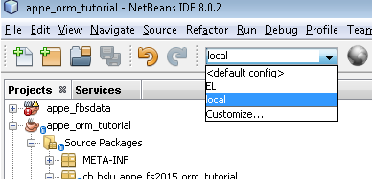
Pitfalls and Best Practices
Multiple Persistence Units
Multiple project configurations with different persistence units
Easily switch between local and remote databases
Easily switch between different database generation strategies

Slide 28
Pitfalls and Best Practices
Multithread Environment
Possible reasons for multiple threads:
Fat clients often use multi-threading, to separate service calls and rendering to avoid freezing windows.
Service / Application-Frameworks may use multi-threading to increase performance, improve response time or enable load balancing
…
Note:
Entity Manager are not thread-safe
Do not share entity manager and other JPA objects among multiple threads
Use transactions to isolate threads operations
Choose adequate transaction isolation setting
Transaction isolation settings are always a trade-off between accuracy and speed.
Further Reading:
http://en.wikipedia.org/wiki/Isolation_%28database_systems%29

Slide 29
Pitfalls and Best Practices
Tips
Using multiple entity manager is possible, but more difficult to handle (every entity manager has its own context)
Entity Manager are not thread-safe: do not share an entity manager among multiple threads
Always perform modification to entities within transactions
Note that modifications are not stored to the database before the end of the transaction (commit or flush required)
Keep in mind that already loaded collections are not automatically updated after an entity removal
Use JPA transaction features in the logic layer.
Use only JPQL / JPA in Logic Layer, no SQL
Do not use entities in presentation layer

Slide 30


